Slide 1
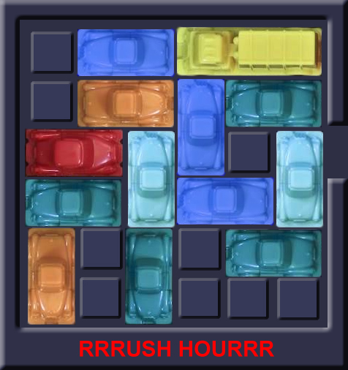
Rushhour
Bart Zeeuw van der Laan
Paloma van Moerkerken
Floor Berkhout
Commit4life

Slide 2


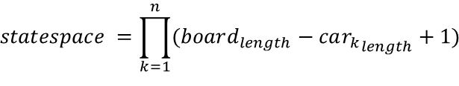

Statespace can be considered as all possible board states
Board specific an upper bound statespace is a function of all possible car positions and is
Generic formula
$$n=total cars on the board$$
Car can be in board_{length} – 1 positions
Horizontal cars can only move in their row
No limits assumed
Cars can be placed on top of each other for simplicity (this overestimates the space)
$$statespace =\prod_{k=1}^{n}{(board_{length}−{car_{k}}_{length}+1)}$$
6x6, game 1
2 x 2 x 3 x 3 x 5 x 3 x 3 x 5 x 5
x 4 x 3 x 3 x 5 = 7.290.000
Possible states is a function of positions of all cars
Calculated by the product of all separate cars possitions
Vertical cars same logic
Logic similar to horizontal cars that can be in every place of their row
Notes:
Teveel tekst

Slide 3
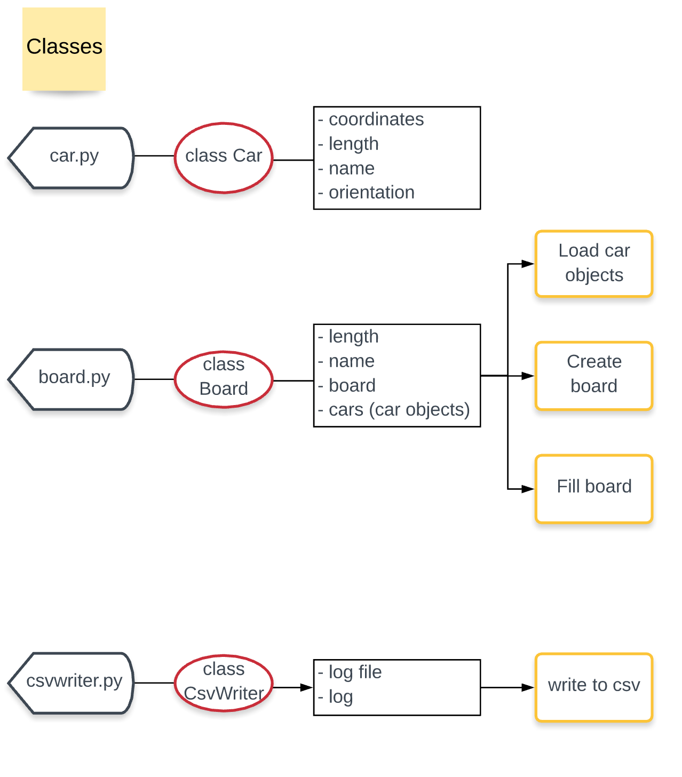
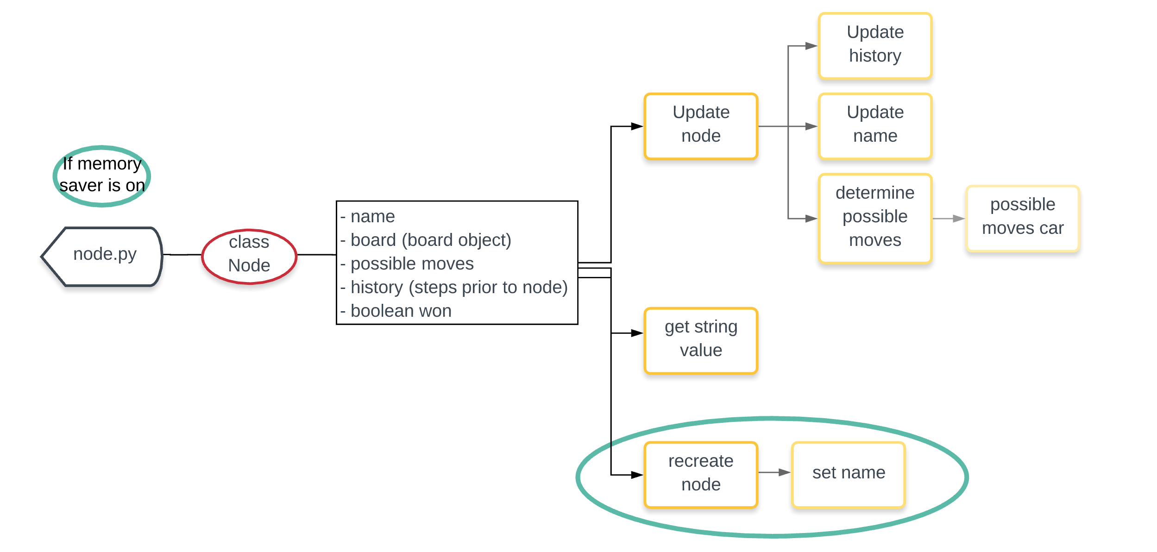
Setup
Notes:
Heel kort!

Slide 4
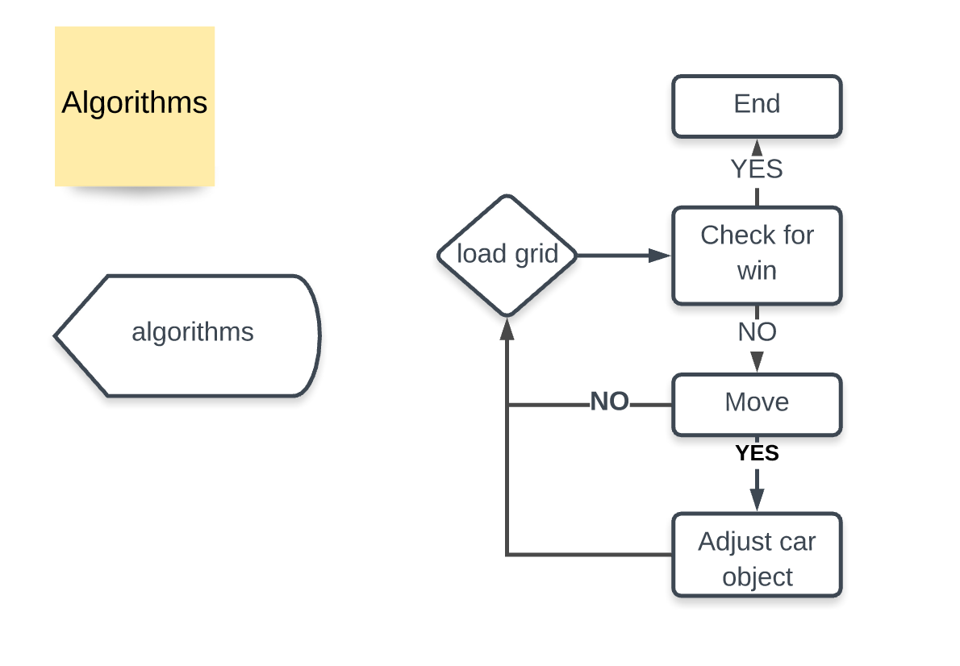
Notes:
Niet nodig

Slide 5
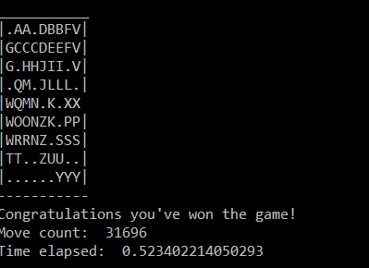
Visualization
Simple graphical

Slide 6
Due to the nature of the problem we choose Random and Iterative algorithms
selected
not selected
Class
Algorithm
Rationale
Selected
Random
Random
Simple algorithm
Greedy
?
Constructive
Breadth first
Able to find the most optmal solution in the shortest amount of time
Depth first
Able to find a quick solution
Iterative deepening
?
Iterative
Hill climber
No clear score of state possible therefore we didn’t use iterative algorithms
Simulated anealing

Slide 7

Our algorithms
In terms of completion and if completed: move count
 | 6x6_1 | 6x6_2 | 6x6_3 | 9x9_4 | 9x9_5 | 9x9_6 | 12x12_7
Randomize | 10607 | 1932 | 28390 | 28842
Improved random | 406 | 821 | 5205 | 16137
Depth-first | 186 | 246 | 943
Depth-first randomized | 27 | 22 | 58
Breadth-first | 21 | 15 | 33 | 27
Solved board
Unsolved board
Unknown
Average 100x
Notes:
Geef avarages van de alforithmes weer!

Slide 8




Random algorithm is able to give a valid solution for first 6 games
Description
Take-aways
Efficiency very low algorithm does a lot of similar steps
Room for improvement
Check for win is not efficient
Check if won
Continue if not won
Pick a random car
From all the cars
4
1
Random algorithm
Input the move in the game
If possible perform the move
3
2
Pick a random move
From the list [-1, 1]

Slide 9
Random advanced algorithm met heuristiek
Description
Take-aways
Check if won
Continue if not won
By checking if no other car is blocking the X car
Is expected to need more time for the extra steps
It surely doesn’t find the optimal solution
Pick a random car
From the moveable cars
4
1
Random
advanced algorithm
Pick a random move
From the list [-1, 1]
If the same car is moved multiple times in a row, this is seen as one move
Input the move in the game
If possible perform the move
3
2

Slide 10
Breadth-first & depth-first
1.0
New board state
1.1.0
Similar board state (shut off node)
Visualization
Description
Nodes represent board states
Branches represent moves
Level represents number of moves
0.0.0
0: A-1
0.0
1: B-1
0: A-1
0.1.0
Algorithm
Take the node highest up the tree
Identify all possible moves
Create the corresponding nodes
Compare the new nodes with nodes earlier up the tree
Check if the game is won
Shut of nodes that represent a board state that was achieved before
Repeat
0
1: B-1
0.1
1: B+1
1.1.0
1.2.0
2: K+1
0: B-1
0.2
1: A-1
1.2.1
Notes:
10

Slide 11
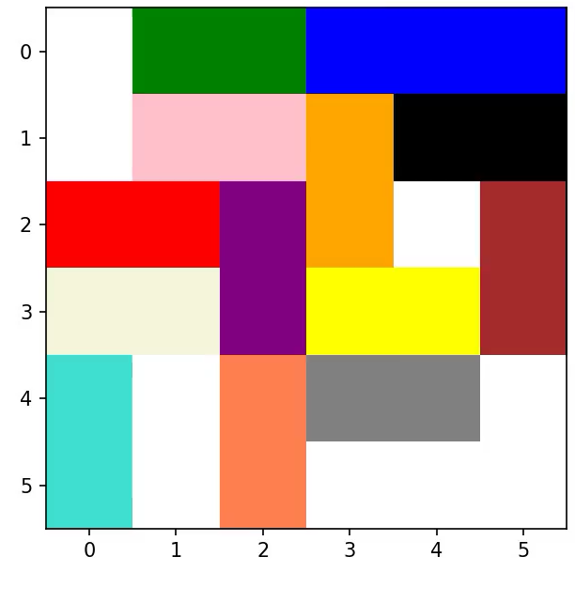
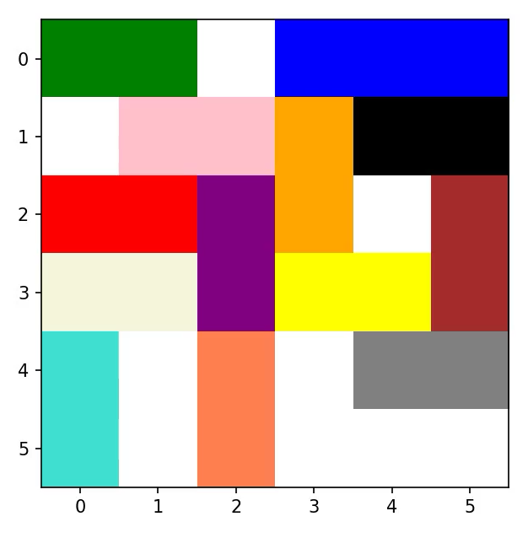
Board 6 x 6, game 1
Depth-first
Breadth-first
Notes:
Tijdens runnen praten

Slide 12
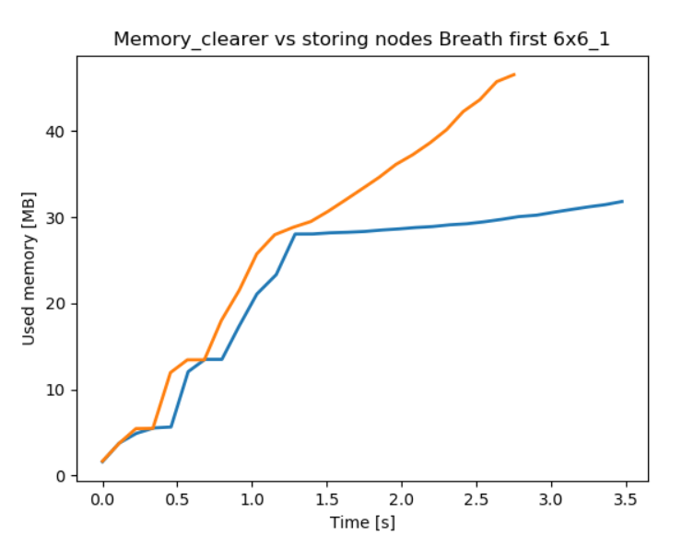
Not storing nodes saves memory but uses extra processing time
Standard
Memory saver
Working principle
Stores objects
Computes objects every time
Resuls
Plots

Slide 13
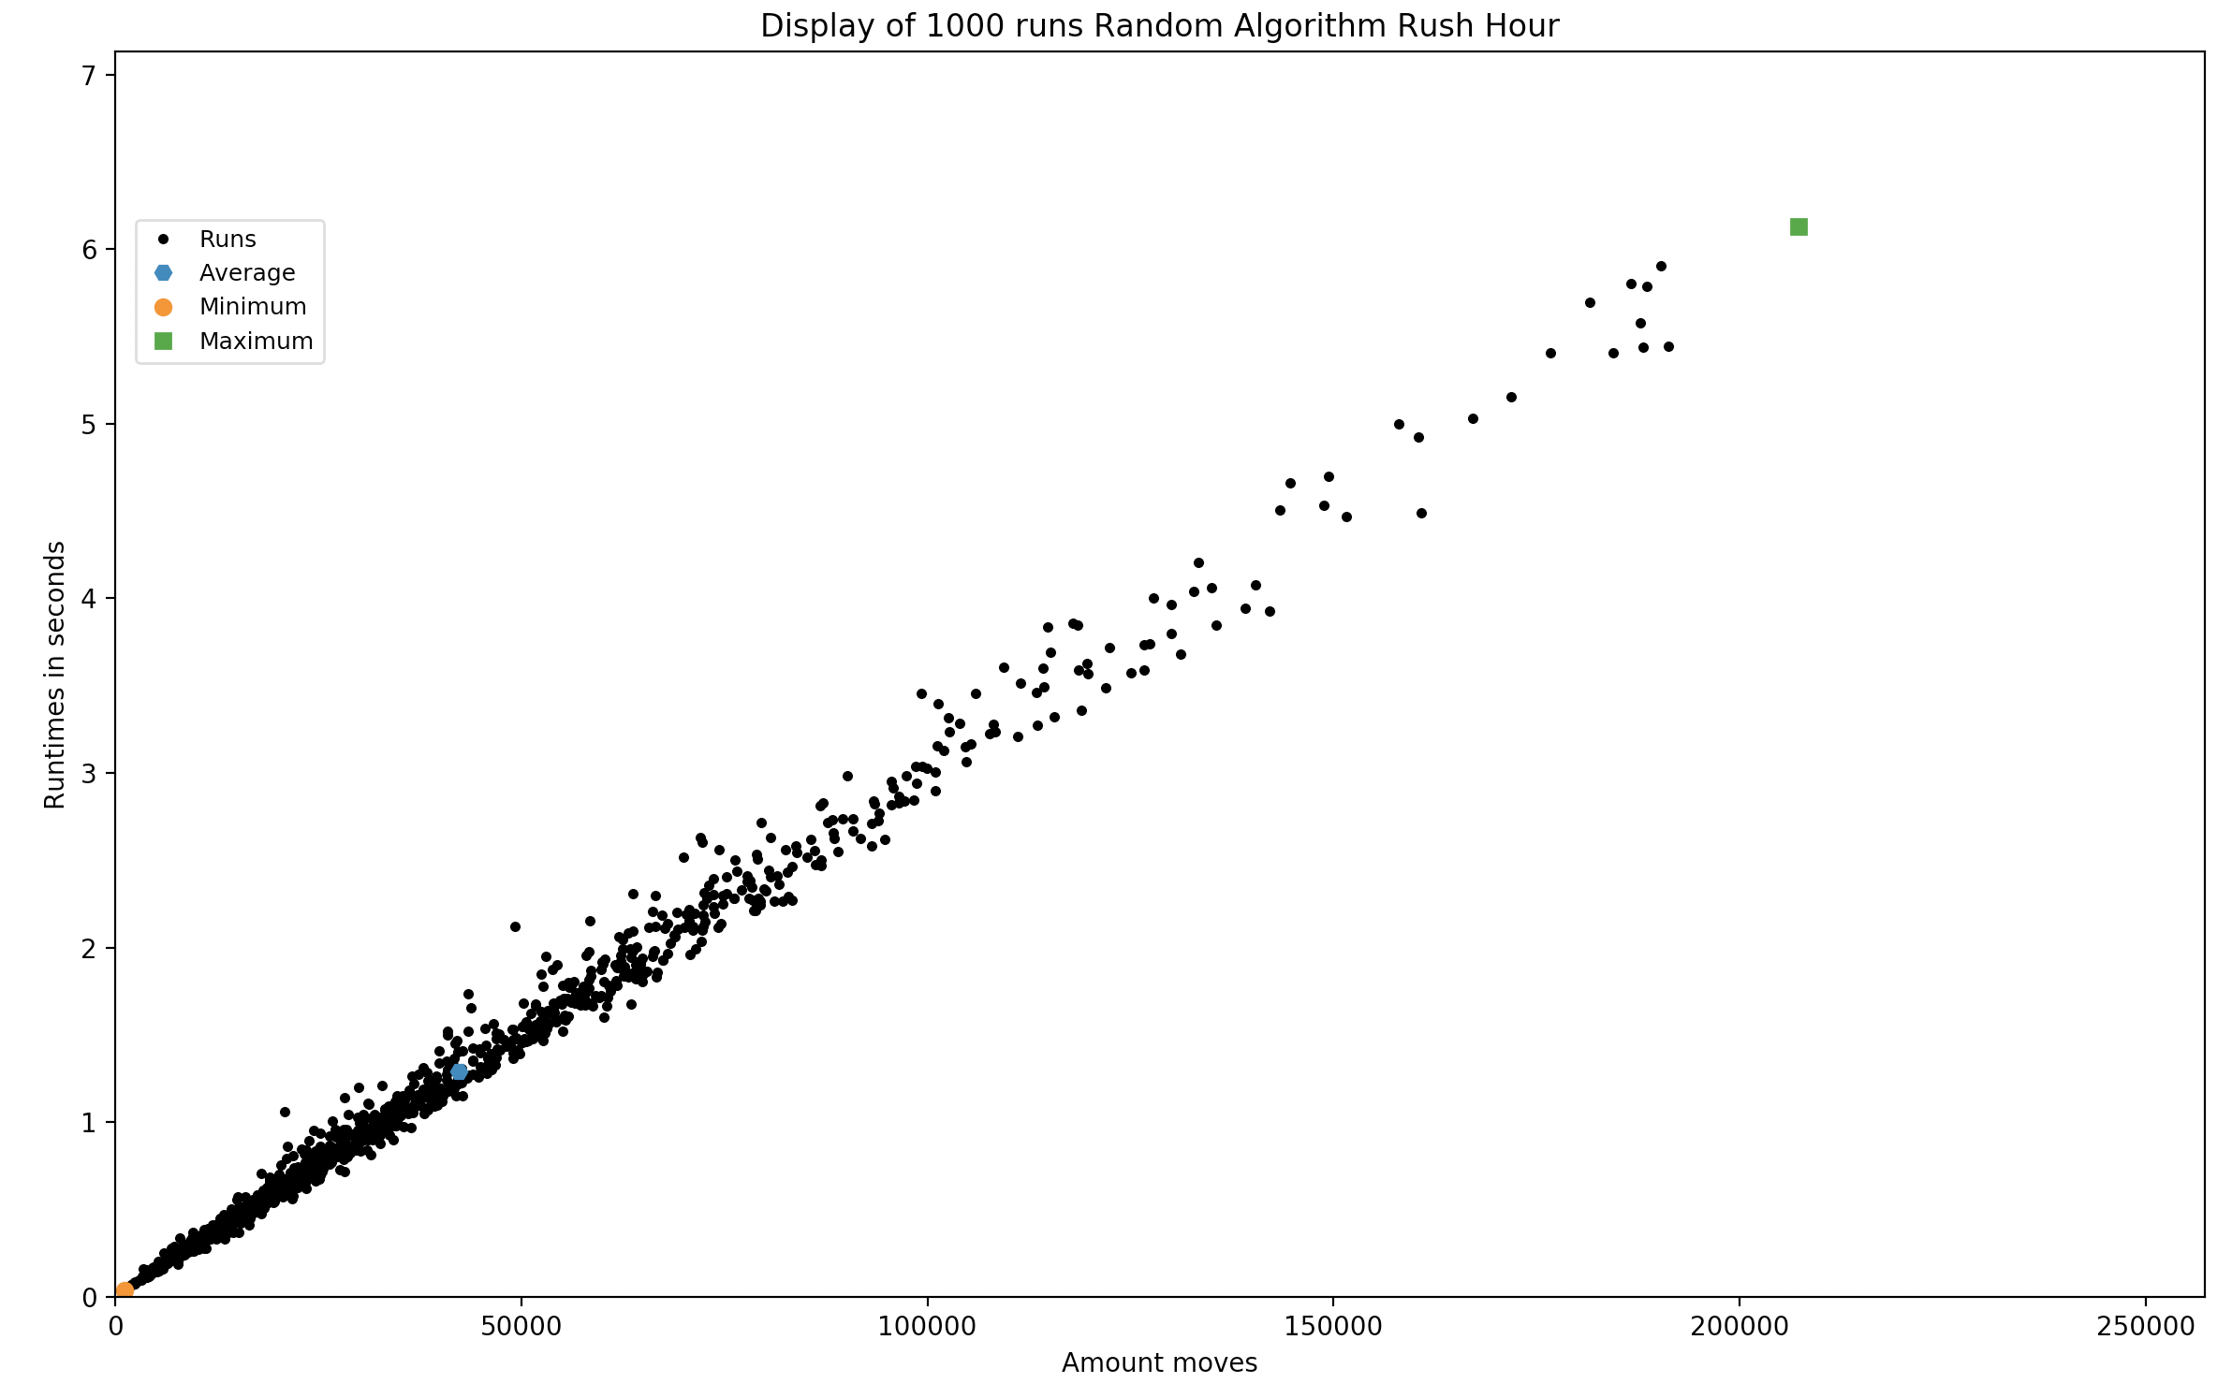
Random algorithm test
Board 6x6 game 1
Take-aways
To compare the lower and upper bound with the random advanced algorithm, breadth-first and depth-first.

Slide 14
Comparison of the algorithms
Board 6x6, game 1
Algorithms
Random algorithm 100x
Advanced random 100x
Depth-first
Breadth-first
Moves Lower bound, in case of. | Time Lower bound, in case of. seconds | Average moves | Average time seconds | Upper bound moves | Upper bound time seconds
317 | 0.01 | 5548 | 4.95 | 114266 | 2.33
332 | 0.06 | 4154 | 4.96 | 20039 | 3.82
186 | 1.086
21 | 0.954
Notes:
14
Random 1000 x runnen
Pstat
Python3 time main.py

Slide 15
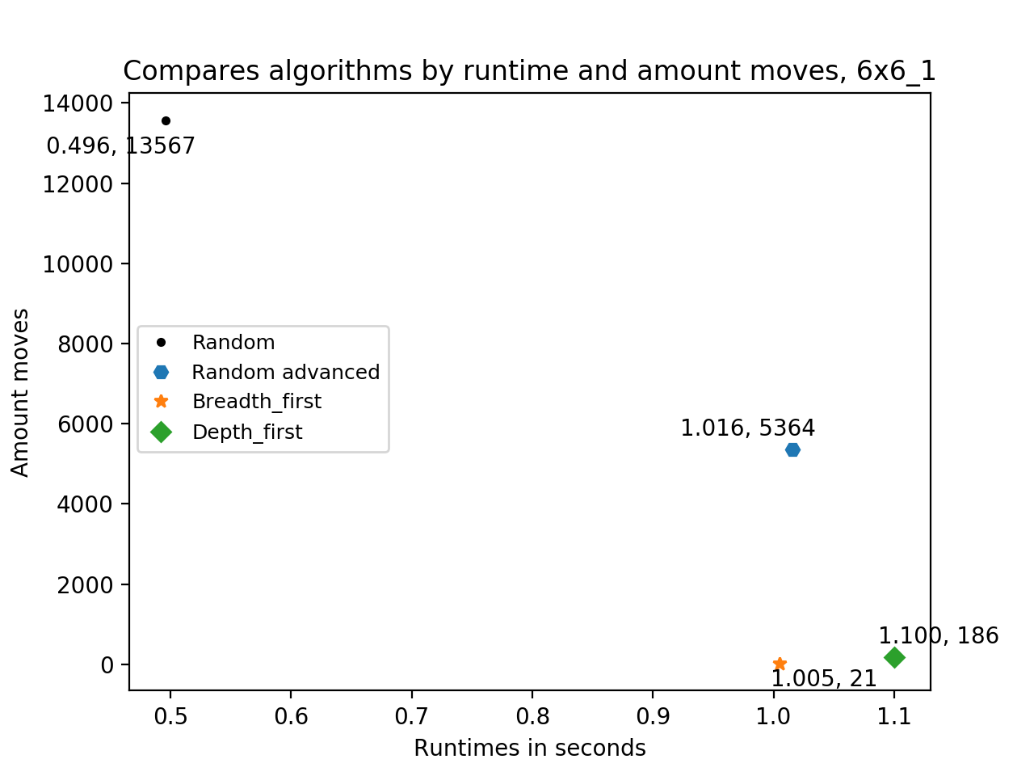
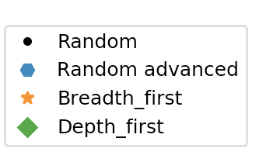
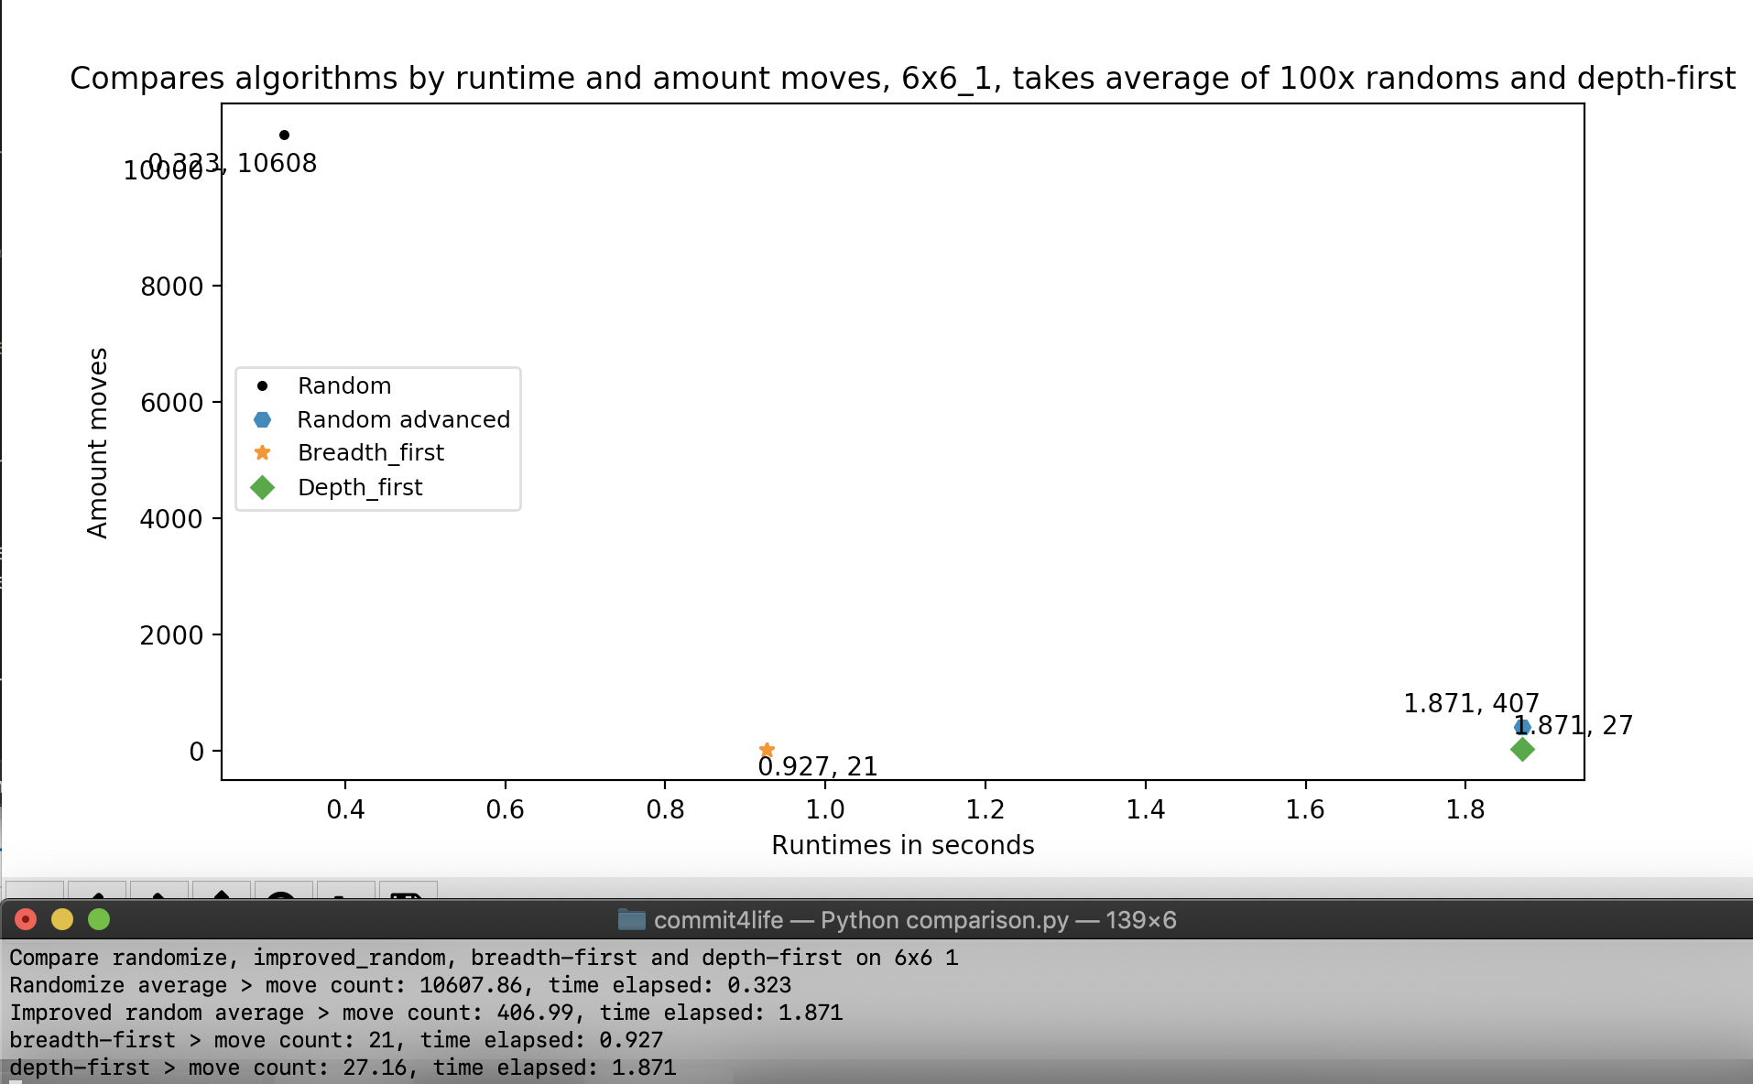
Comparison of the algorithms
Board 6x6, game 1
Notes:
15
Betere vergelijking? Bedenken hoe
Alle borden laten zien, niet alleen 6x6!

Slide 16

Project planning
3
Current state
Advanced (optional)
4
3
Create random boards
Solve the random created boards and determine what is the difficulty in solving them
2
Advanced algorithms
Optimization memory
Data visualization
1
Random algorithm
Simple algorithm able to solve the simple boards
Simple gameplay possible
Game playable by hand
Notes:
16
Depth random maken
Random prunen tussen 2 dezelfde borden
Minder tekst
Deze naar voren en wat we gaan doen

